Slide 1

What drives species distributions?
Petr Keil
Notes:
Hi, my name is Petr Keil and this is my project Biodiversity dynamics across a continuum of space, time, and their scales.

Slide 2
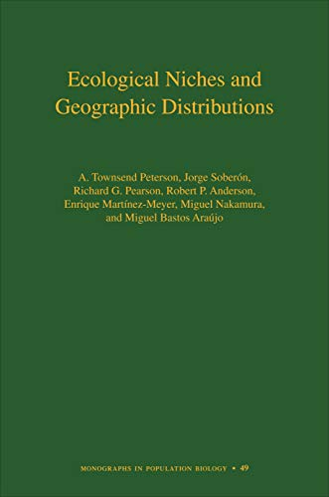
Contents
Ecological niche
Optima, limits
Eltonian vs Grinnellian niche
Fundamental vs Realized niche
Abiotic vs Biotic niche
Phenotypic plasticity, lessons from invasions, time-for-space
SDMs, niche models, applied issues
Climate
Habitats and biomes
Dispersal limits, historical legacies
Townsend Peterson et al. (2011) Ecological Niches and Geographic Distributions. Princeton
Notes:
In this panel we can probably all agree that biodiversity is one of the most valuable natural resources.
But things like climate change or habitat loss are a threat to biodiversity, to the extent that we hear about biodiversity crisis, or sixth mass extinction
For example, about 1% of vertebrate species have gone extinct because of humans

Slide 3
Ecological niche
The fundamental concept of ecology
Notes:
I am qualified to deliver all this

Slide 4
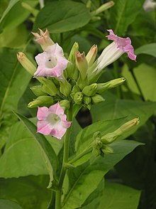
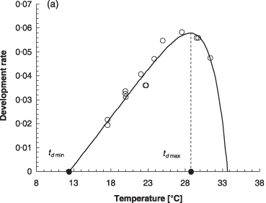
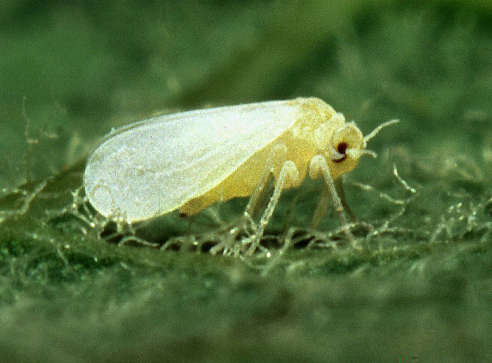
Environment, resources, biotic vs abiotic variables
Resources or “linked” variables (Hutchinson 1978) - consumed/modified by organisms, there may be competition for the resources; hard to model
Scenopoetic (from Greek “setting the stage”) or “non-linked” variables (Hutchinson 1978) or conditions - those that aren’t modified = climate, topography, pH; easy to model
Biotic vs abiotic variables
Bemisia tabaci
Nicotiana tabacum
Dixon et al. (2009) Functional Ecology
Photos: Wikipedia
Notes:
In this panel we can probably all agree that biodiversity is one of the most valuable natural resources.
But things like climate change or habitat loss are a threat to biodiversity, to the extent that we hear about biodiversity crisis, or sixth mass extinction
For example, about 1% of vertebrate species have gone extinct because of humans

Slide 5
Niche – one dimension
optimum
Abundance
Fitness
Survival
Growth rate
limit
limit
Helaouet & Beaugrand (2009) Ecosystems
Temperature
Notes:
In this panel we can probably all agree that biodiversity is one of the most valuable natural resources.
But things like climate change or habitat loss are a threat to biodiversity, to the extent that we hear about biodiversity crisis, or sixth mass extinction
For example, about 1% of vertebrate species have gone extinct because of humans

Slide 6
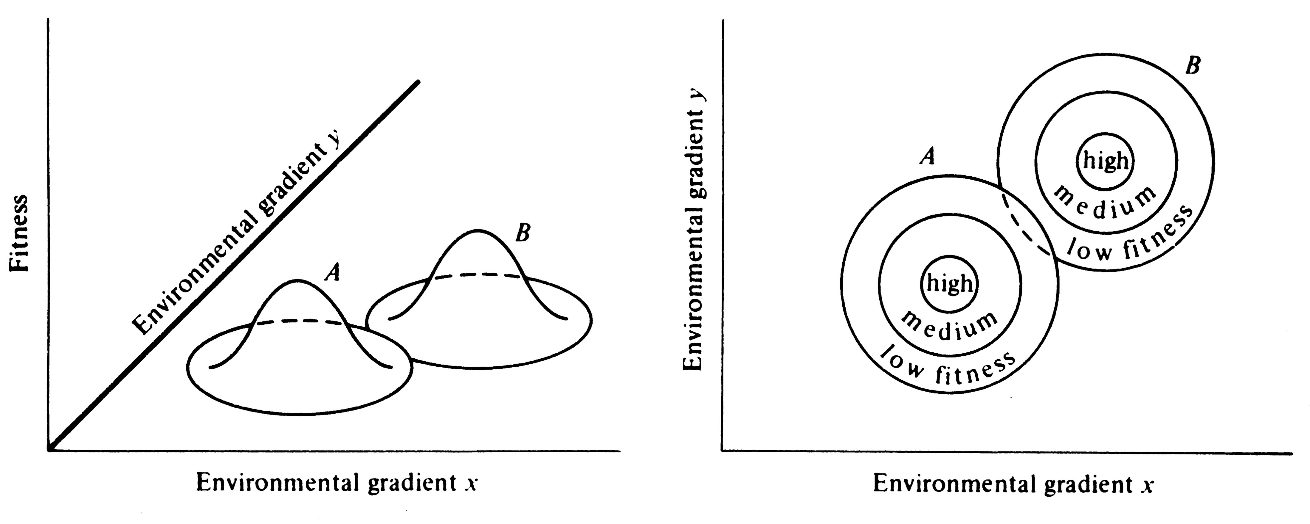
Niche – two dimensions
http://www.zo.utexas.edu/courses/bio373/chapters/Chapter13/Chapter13.html
Notes:
In this panel we can probably all agree that biodiversity is one of the most valuable natural resources.
But things like climate change or habitat loss are a threat to biodiversity, to the extent that we hear about biodiversity crisis, or sixth mass extinction
For example, about 1% of vertebrate species have gone extinct because of humans

Slide 7
Niche
Hutchinson (1957): The total range of conditions under which an individual (or population) lives and replaces itself.
Grinnell (1917, 1924, 1928): Grinnellian niche = conditions or requirements for existence, mostly in the context of scenopoetic variables, e.g. climate
Elton (1927): Eltonian niches = Niche as an impact of the organisms, a.k.a. functional role of the organism in the community (existence is granted, given)
Separating the impacts vs requirements at local spatial scales is difficult, but possible at coarse scale
Silvertown (2006):
Alpha niche: at local scale where interactions with other species occur
Beta niche: the broad habitat where the species is found
Gamma niche: geographic range of species
We will focus on Beta and Gamma
Townsend Peterson et al. (2011) Ecological Niches and Geographic Distributions. Princeton
Notes:
In this panel we can probably all agree that biodiversity is one of the most valuable natural resources.
But things like climate change or habitat loss are a threat to biodiversity, to the extent that we hear about biodiversity crisis, or sixth mass extinction
For example, about 1% of vertebrate species have gone extinct because of humans

Slide 8
Fundamental vs. realized niche
Hutchinson:
Fundamental niche = a set of all scenopoetic variables where species can exist
Realized niche = subset of fund niche where the species is competitive and can survive biotic interactions
Precipitation
Temperature
Townsend Peterson et al. (2011) Ecological Niches and Geographic Distributions. Princeton
Notes:
In this panel we can probably all agree that biodiversity is one of the most valuable natural resources.
But things like climate change or habitat loss are a threat to biodiversity, to the extent that we hear about biodiversity crisis, or sixth mass extinction
For example, about 1% of vertebrate species have gone extinct because of humans

Slide 9
Potential vs realized geographic range
Hutchinson:
Fundamental niche = a set of all scenopoetic variables where species can exist
Realized niche = subset of fund niche where the species is competitive and can survive biotic interactions
Realized vs potential range
Precipitation
Temperature
Townsend Peterson et al. (2011) Ecological Niches and Geographic Distributions. Princeton
Notes:
In this panel we can probably all agree that biodiversity is one of the most valuable natural resources.
But things like climate change or habitat loss are a threat to biodiversity, to the extent that we hear about biodiversity crisis, or sixth mass extinction
For example, about 1% of vertebrate species have gone extinct because of humans

Slide 10
Geographic vs environmental space
Townsend Peterson et al. (2011) Ecological Niches and Geographic Distributions. Princeton
Notes:
In this panel we can probably all agree that biodiversity is one of the most valuable natural resources.
But things like climate change or habitat loss are a threat to biodiversity, to the extent that we hear about biodiversity crisis, or sixth mass extinction
For example, about 1% of vertebrate species have gone extinct because of humans

Slide 11
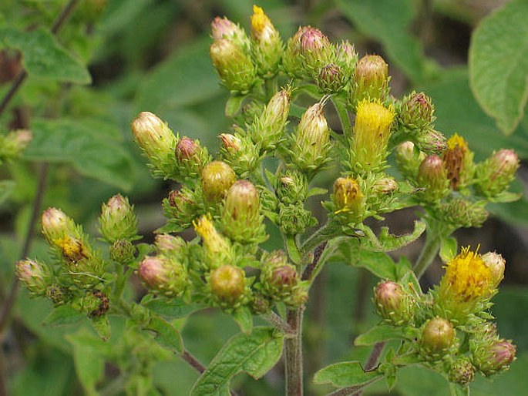
Geographic vs environmental space
Inula conyzae (Oman hnidák)
One location in climatic space may correspond to multiple locations in geographic space, but not the other way round.
Sporbert et al. (2019) J. Biogeogr.
Notes:
In this panel we can probably all agree that biodiversity is one of the most valuable natural resources.
But things like climate change or habitat loss are a threat to biodiversity, to the extent that we hear about biodiversity crisis, or sixth mass extinction
For example, about 1% of vertebrate species have gone extinct because of humans

Slide 12
Ecological Niche Models
a.k.a. Species Distribution Models (SDM)
Notes:
I am qualified to deliver all this

Slide 13
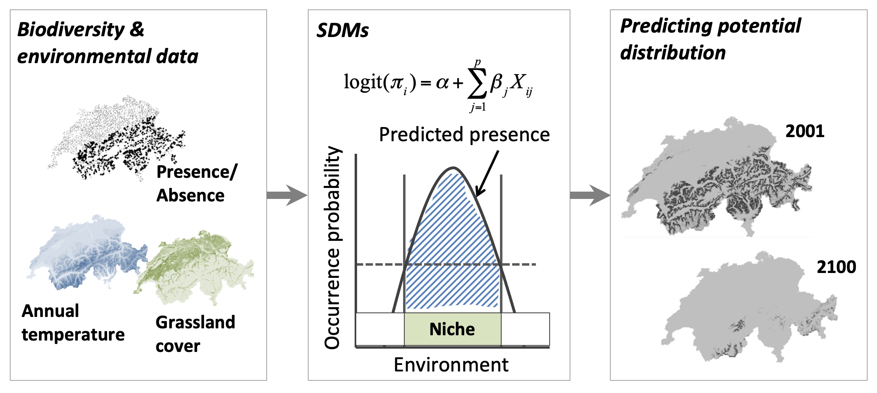
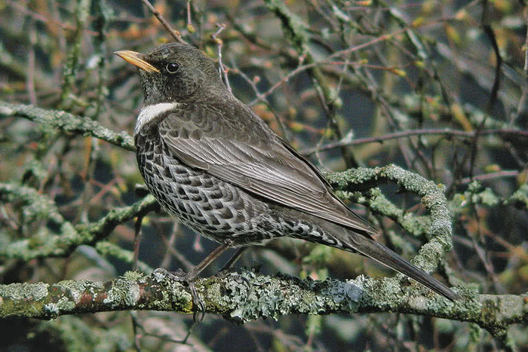
Niche models a.k.a. Species Distribution Models (SDM)
Turdus torquatus
For more info on how they work see the upcoming practical class!
Scheme by Damaris Zurell: https://damariszurell.github.io/SDM-Intro/
ENM 2020: https://journals.ku.edu/jbi/article/view/15016
Notes:
In this panel we can probably all agree that biodiversity is one of the most valuable natural resources.
But things like climate change or habitat loss are a threat to biodiversity, to the extent that we hear about biodiversity crisis, or sixth mass extinction
For example, about 1% of vertebrate species have gone extinct because of humans

Slide 14
Applications of SDM
Predicting into unsurveyed times and locations
Future projections under climate change
Species discovery
Disease vector mapping
Conservation biology
Characterizing potential distribution and invasion potential of species
Assessment of habitat requirements / niche
Niche evolution
Townsend Peterson et al. (2011) Ecological Niches and Geographic Distributions. Princeton
Notes:
In this panel we can probably all agree that biodiversity is one of the most valuable natural resources.
But things like climate change or habitat loss are a threat to biodiversity, to the extent that we hear about biodiversity crisis, or sixth mass extinction
For example, about 1% of vertebrate species have gone extinct because of humans

Slide 15
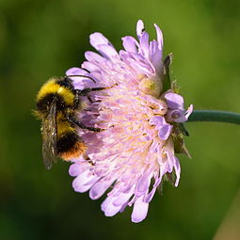
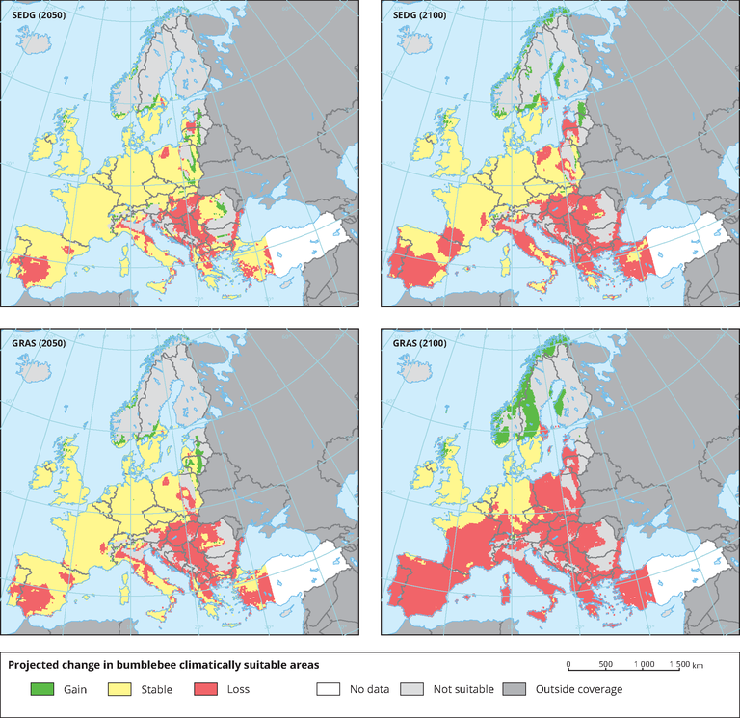
Future forecasts of diversity and distributions
Bombus campestris
It assumes time-for-space substitution. Can it work?
Rasmont et al. (2015) BioRisk
Notes:
In this panel we can probably all agree that biodiversity is one of the most valuable natural resources.
But things like climate change or habitat loss are a threat to biodiversity, to the extent that we hear about biodiversity crisis, or sixth mass extinction
For example, about 1% of vertebrate species have gone extinct because of humans

Slide 16
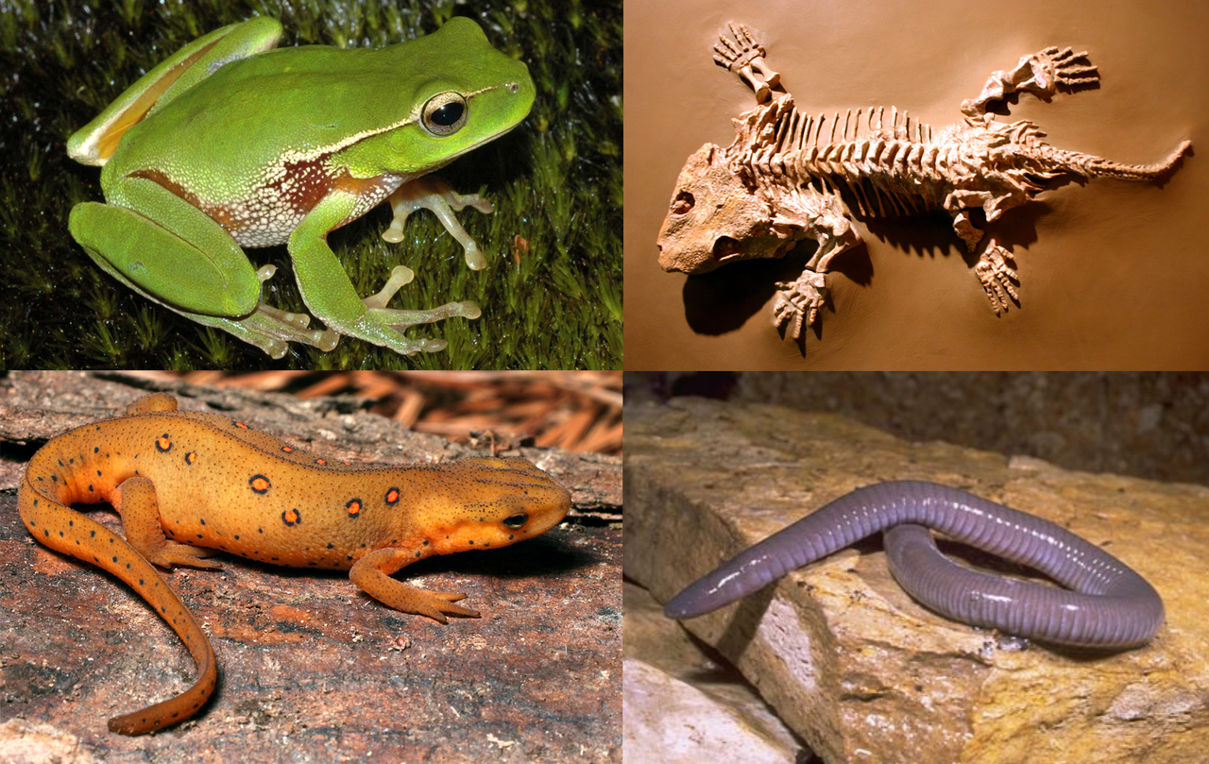
Future forecasts of diversity and distributions
Current amphibian richness
Projected future threat from climate change
It assumes time-for-space substitution. Can it work?
Hof et al. (2011) Nature
Notes:
In this panel we can probably all agree that biodiversity is one of the most valuable natural resources.
But things like climate change or habitat loss are a threat to biodiversity, to the extent that we hear about biodiversity crisis, or sixth mass extinction
For example, about 1% of vertebrate species have gone extinct because of humans

Slide 17
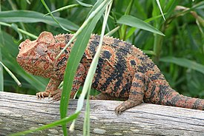
Discovering biodiversity
Furcifer oustaleti
Raxworthy et al. (2003) Nature
Notes:
In this panel we can probably all agree that biodiversity is one of the most valuable natural resources.
But things like climate change or habitat loss are a threat to biodiversity, to the extent that we hear about biodiversity crisis, or sixth mass extinction
For example, about 1% of vertebrate species have gone extinct because of humans

Slide 18
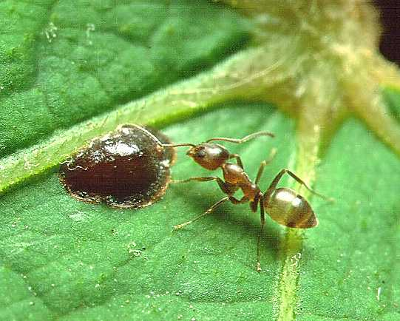
Invasion biology
Linephithema humile
Townsend Peterson et al. (2011)
Roura-Pascual et al. (2005)
Notes:
In this panel we can probably all agree that biodiversity is one of the most valuable natural resources.
But things like climate change or habitat loss are a threat to biodiversity, to the extent that we hear about biodiversity crisis, or sixth mass extinction
For example, about 1% of vertebrate species have gone extinct because of humans

Slide 19
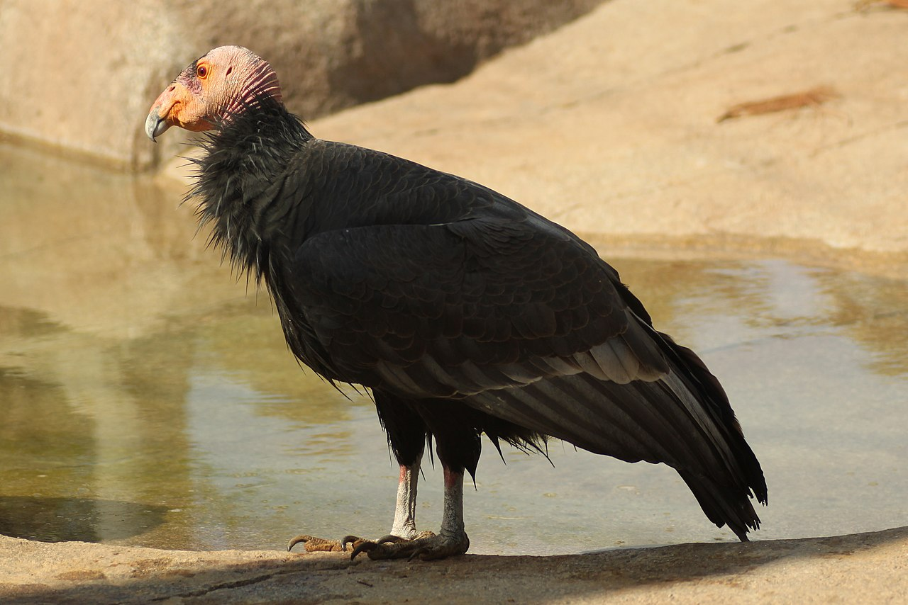
Reintroductions
Gymnogyps californianus
Townsend Peterson et al. (2011)
Martinez-Meyer et al. (2006)
Notes:
In this panel we can probably all agree that biodiversity is one of the most valuable natural resources.
But things like climate change or habitat loss are a threat to biodiversity, to the extent that we hear about biodiversity crisis, or sixth mass extinction
For example, about 1% of vertebrate species have gone extinct because of humans

Slide 20
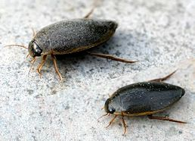
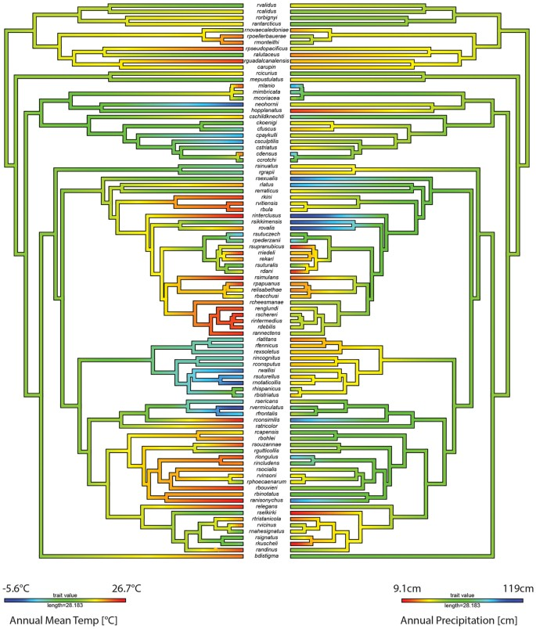
Evolutionary biology
Colymbetes fuscus
Moriniere et al. (2016) Sci. Rep.
Notes:
In this panel we can probably all agree that biodiversity is one of the most valuable natural resources.
But things like climate change or habitat loss are a threat to biodiversity, to the extent that we hear about biodiversity crisis, or sixth mass extinction
For example, about 1% of vertebrate species have gone extinct because of humans

Slide 21
Epidemiology – disease mapping
Coro (2020) Ecological Modelling
Carlson et al. (2020) Nature Ecol. Evol.
Notes:
In this panel we can probably all agree that biodiversity is one of the most valuable natural resources.
But things like climate change or habitat loss are a threat to biodiversity, to the extent that we hear about biodiversity crisis, or sixth mass extinction
For example, about 1% of vertebrate species have gone extinct because of humans

Slide 22
Main problems
Niche models often rely only on climate, while other complex mechanisms are at play
Time-for-space substitution may not work
Realized niches emerge due to geographic barriers
We often have presence-only data, i.e. we know where species is, but we don’t know where it isn’t.
Townsend Peterson et al. (2011) Ecological Niches and Geographic Distributions. Princeton
Notes:
In this panel we can probably all agree that biodiversity is one of the most valuable natural resources.
But things like climate change or habitat loss are a threat to biodiversity, to the extent that we hear about biodiversity crisis, or sixth mass extinction
For example, about 1% of vertebrate species have gone extinct because of humans

Slide 23
Drivers of distributions + data
Climate, biotic interactions, and dispersal limits
Notes:
I am qualified to deliver all this

Slide 24
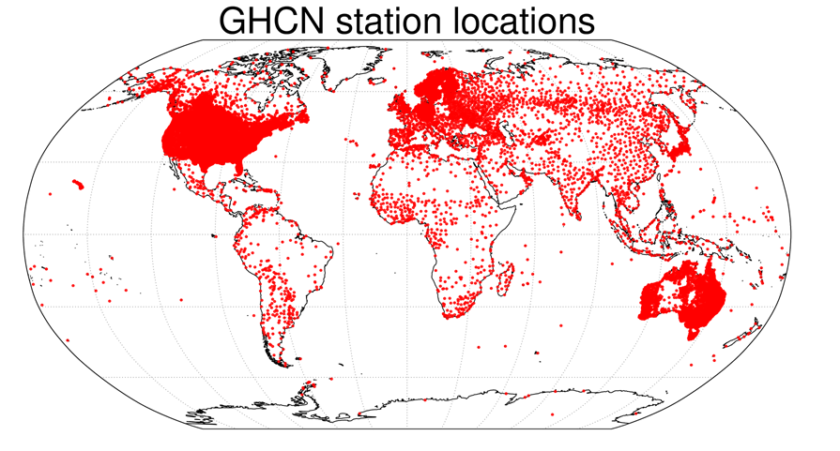
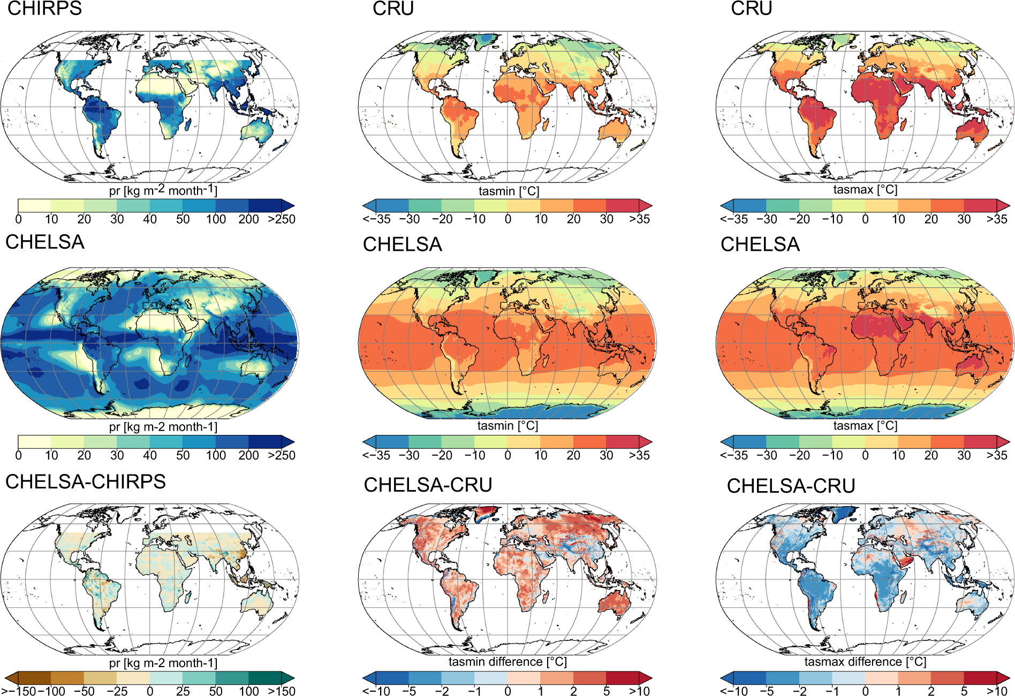
Climate – the #1 suspect behind large-scale ecological patterns
WorldClim: https://www.worldclim.org/
CHELSA: https://chelsa-climate.org/
Notes:
In this panel we can probably all agree that biodiversity is one of the most valuable natural resources.
But things like climate change or habitat loss are a threat to biodiversity, to the extent that we hear about biodiversity crisis, or sixth mass extinction
For example, about 1% of vertebrate species have gone extinct because of humans

Slide 25
Habitats, land cover classes, biomes
Habitat = species-specific, physical manifestation of species’
niche
Habitat type or biotope = for whole assemblages
… the semantics is a bit loose and messy.
Chytrý et al. (2010)
Notes:
In this panel we can probably all agree that biodiversity is one of the most valuable natural resources.
But things like climate change or habitat loss are a threat to biodiversity, to the extent that we hear about biodiversity crisis, or sixth mass extinction
For example, about 1% of vertebrate species have gone extinct because of humans

Slide 26
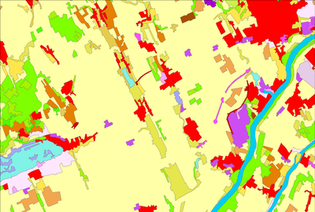
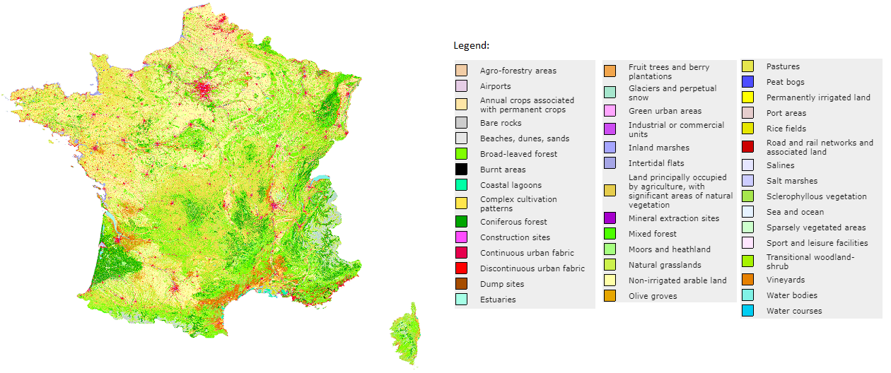
Habitats, land cover classes, biomes
Europe CORINE Land Cover: https://land.copernicus.eu/pan-european/corine-land-cover
Global GlobCover, MODIS, GLC2000, DISCover: http://www.earthenv.org/landcover
Notes:
In this panel we can probably all agree that biodiversity is one of the most valuable natural resources.
But things like climate change or habitat loss are a threat to biodiversity, to the extent that we hear about biodiversity crisis, or sixth mass extinction
For example, about 1% of vertebrate species have gone extinct because of humans

Slide 27
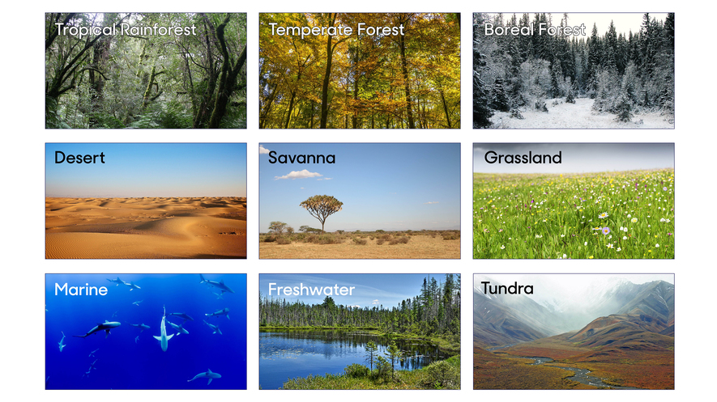
Habitats, land cover classes, biomes
Biomes of the world, source: https://en.wikipedia.org/wiki/Biome
Notes:
In this panel we can probably all agree that biodiversity is one of the most valuable natural resources.
But things like climate change or habitat loss are a threat to biodiversity, to the extent that we hear about biodiversity crisis, or sixth mass extinction
For example, about 1% of vertebrate species have gone extinct because of humans

Slide 28
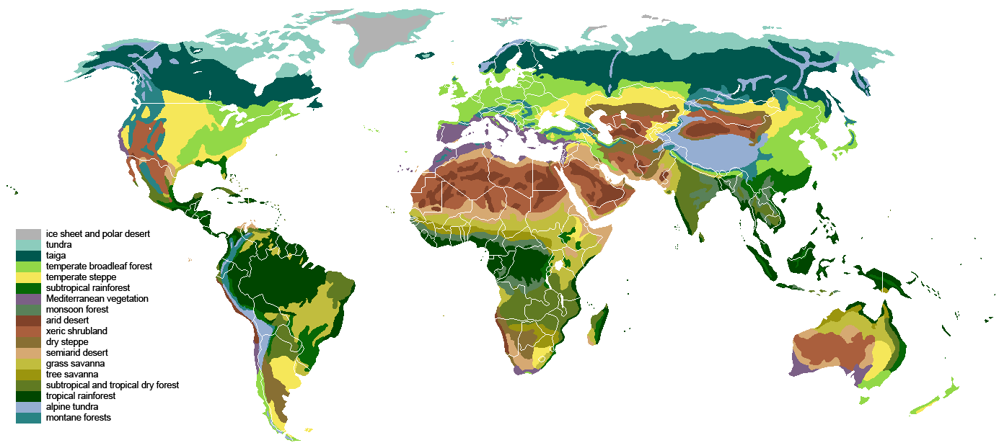
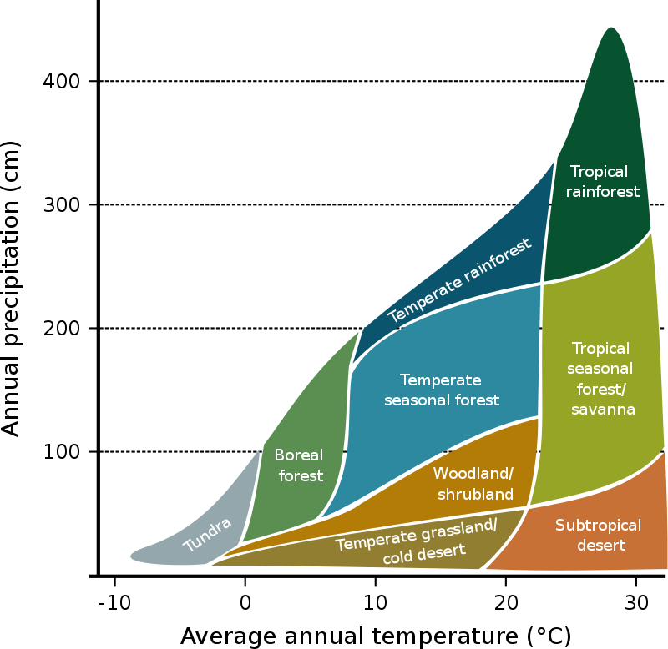
Habitats, land cover classes, biomes
Biomes of the world, source: https://en.wikipedia.org/wiki/Biome
Notes:
In this panel we can probably all agree that biodiversity is one of the most valuable natural resources.
But things like climate change or habitat loss are a threat to biodiversity, to the extent that we hear about biodiversity crisis, or sixth mass extinction
For example, about 1% of vertebrate species have gone extinct because of humans

Slide 29
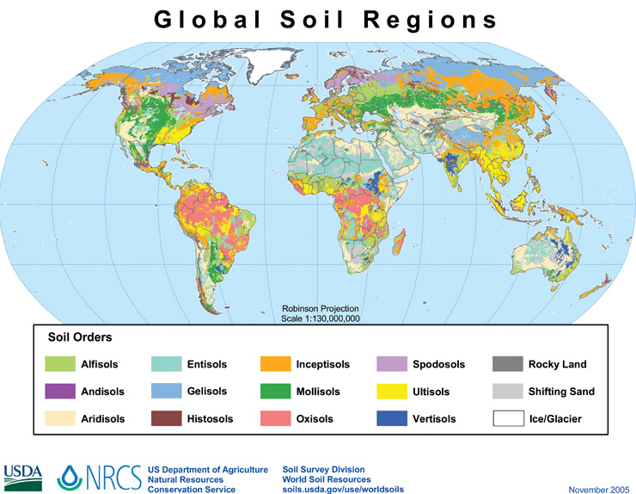
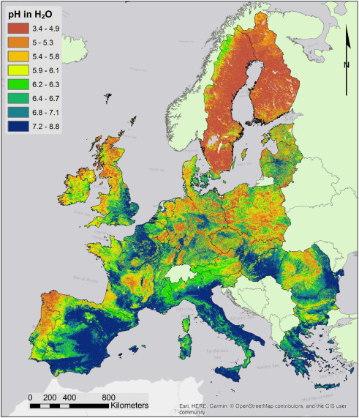
Geology, soils, pH
Ballabio et al. (2019) Geoderma
Notes:
In this panel we can probably all agree that biodiversity is one of the most valuable natural resources.
But things like climate change or habitat loss are a threat to biodiversity, to the extent that we hear about biodiversity crisis, or sixth mass extinction
For example, about 1% of vertebrate species have gone extinct because of humans

Slide 30
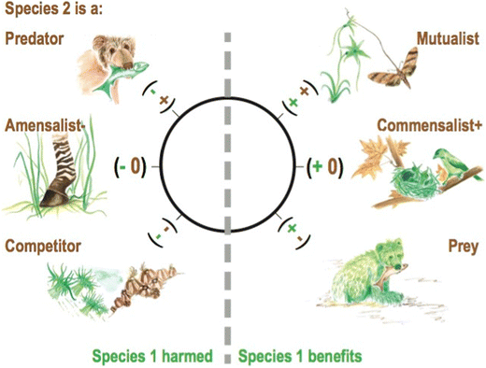
Biotic (interspecific) interactions
Species may be missing in parts of its range (B, C) and niche (E) because of other species
McCann & Gellner (2020) Theoretical Ecology
Notes:
In this panel we can probably all agree that biodiversity is one of the most valuable natural resources.
But things like climate change or habitat loss are a threat to biodiversity, to the extent that we hear about biodiversity crisis, or sixth mass extinction
For example, about 1% of vertebrate species have gone extinct because of humans

Slide 31
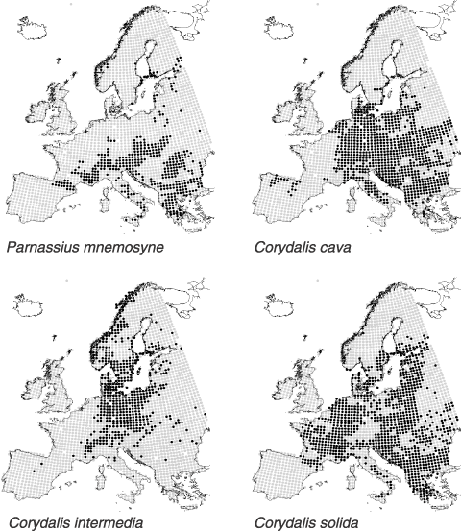
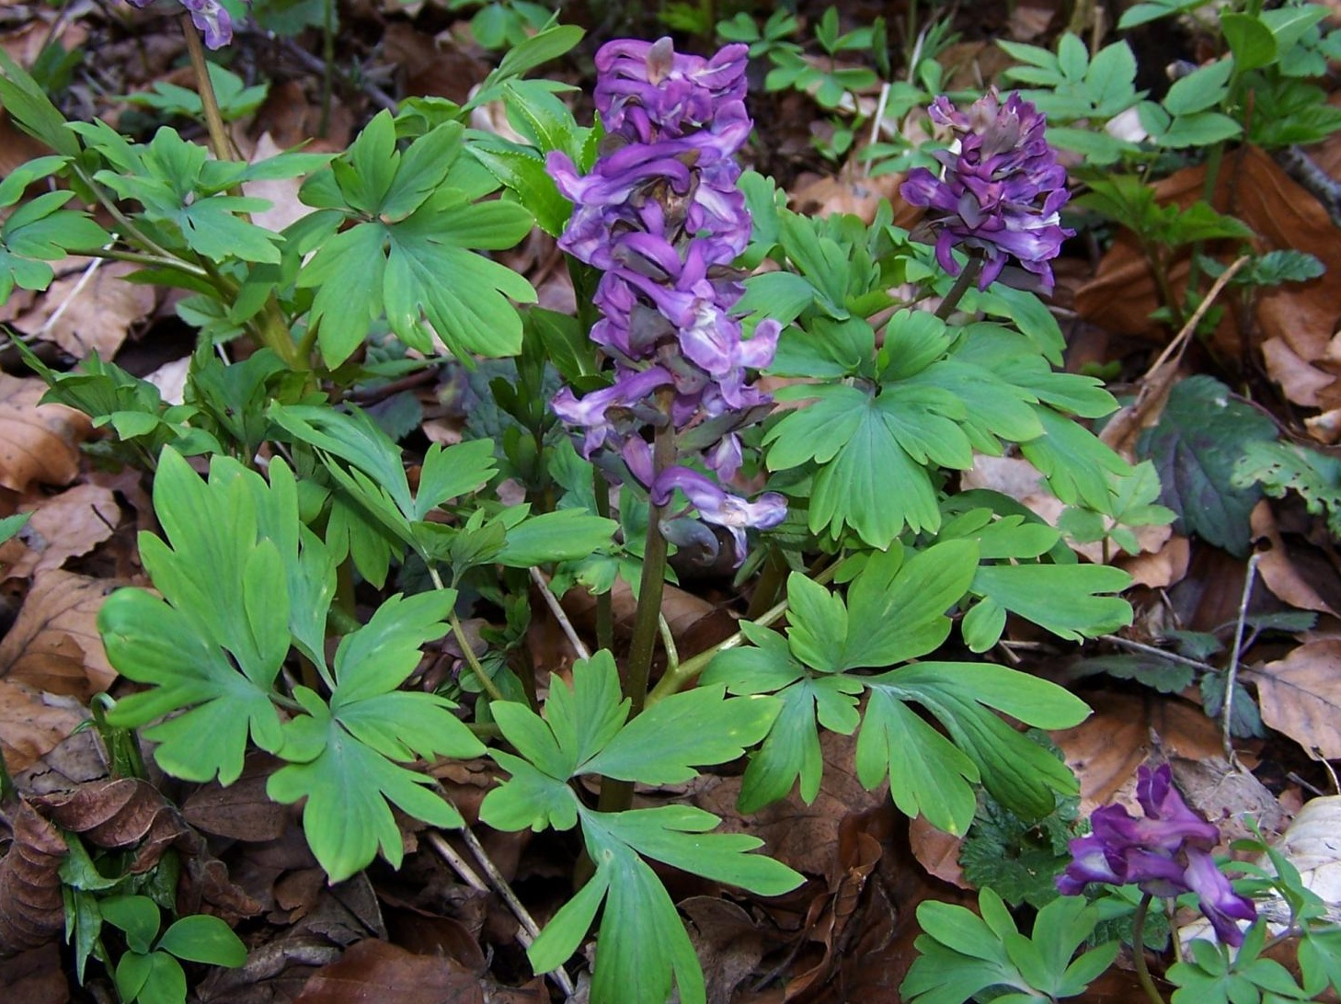
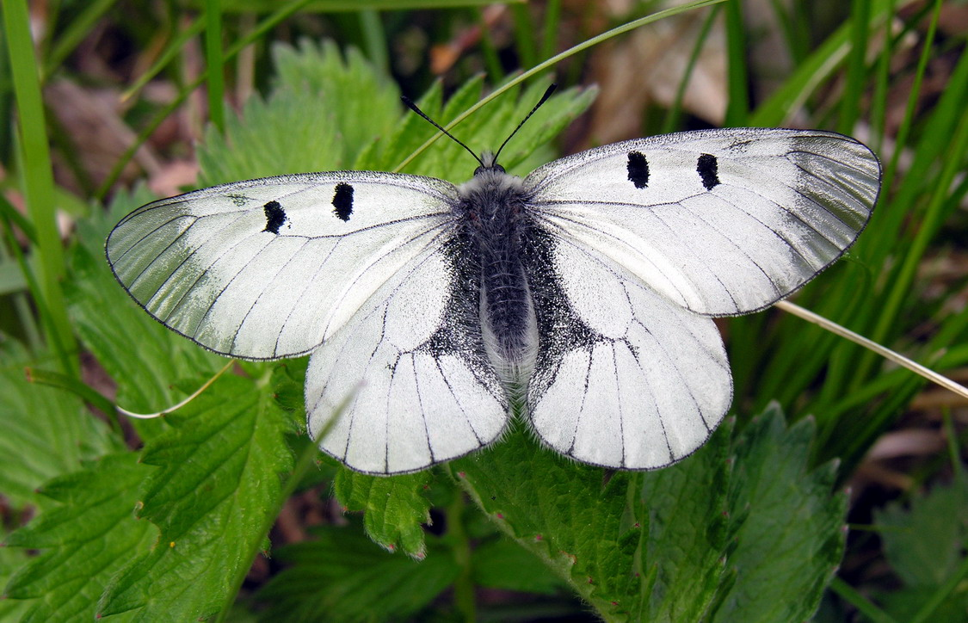
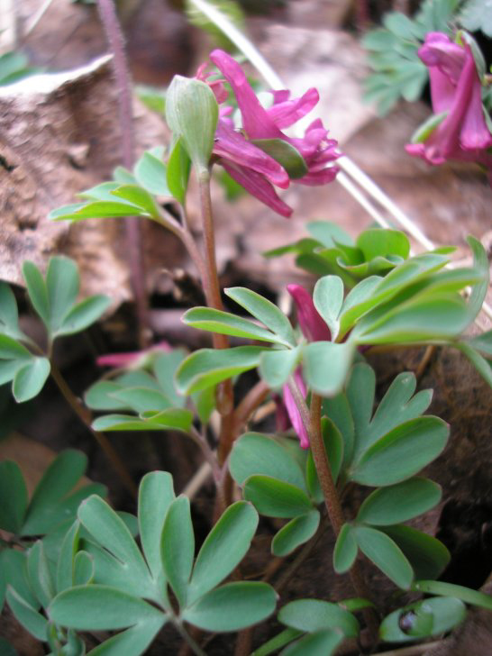
Biotic (interspecific) interactions
Araújo & Luoto (2007) Global Ecology and Biogeogrpahy
Photos: Wikipedia
Notes:
In this panel we can probably all agree that biodiversity is one of the most valuable natural resources.
But things like climate change or habitat loss are a threat to biodiversity, to the extent that we hear about biodiversity crisis, or sixth mass extinction
For example, about 1% of vertebrate species have gone extinct because of humans

Slide 32
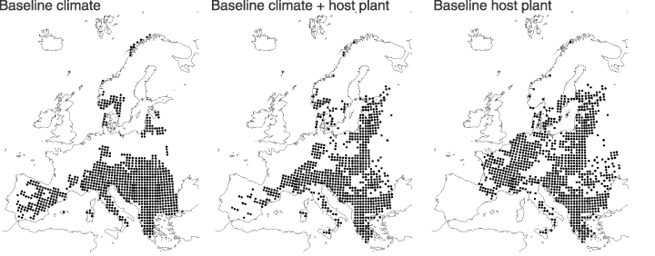
Biotic (interspecific) interactions
Araújo & Luoto (2007) Global Ecology and Biogeogrpahy
Notes:
In this panel we can probably all agree that biodiversity is one of the most valuable natural resources.
But things like climate change or habitat loss are a threat to biodiversity, to the extent that we hear about biodiversity crisis, or sixth mass extinction
For example, about 1% of vertebrate species have gone extinct because of humans

Slide 33
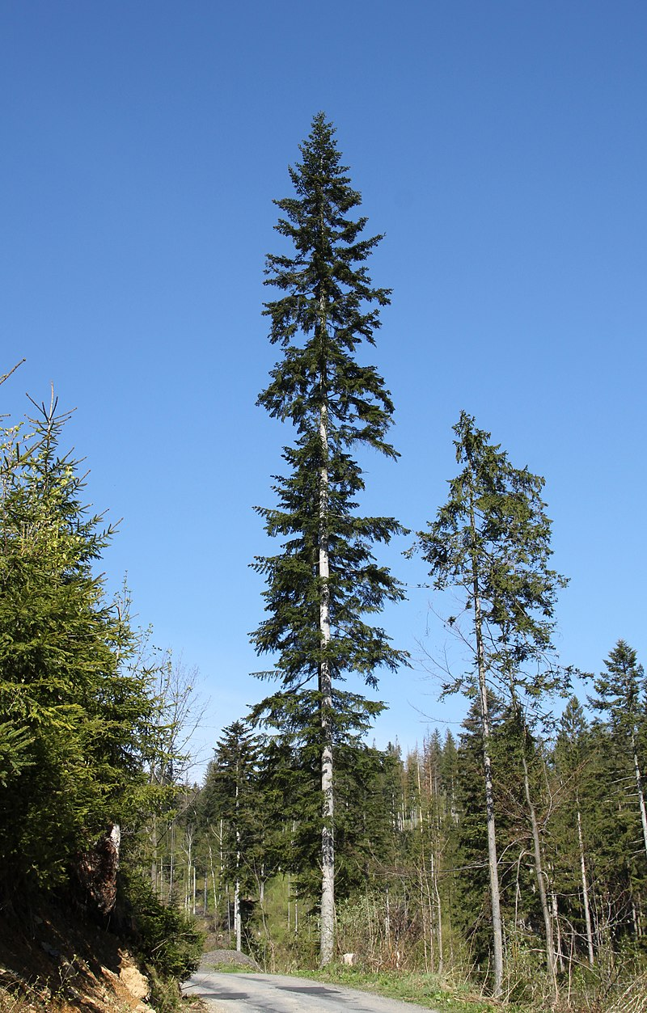
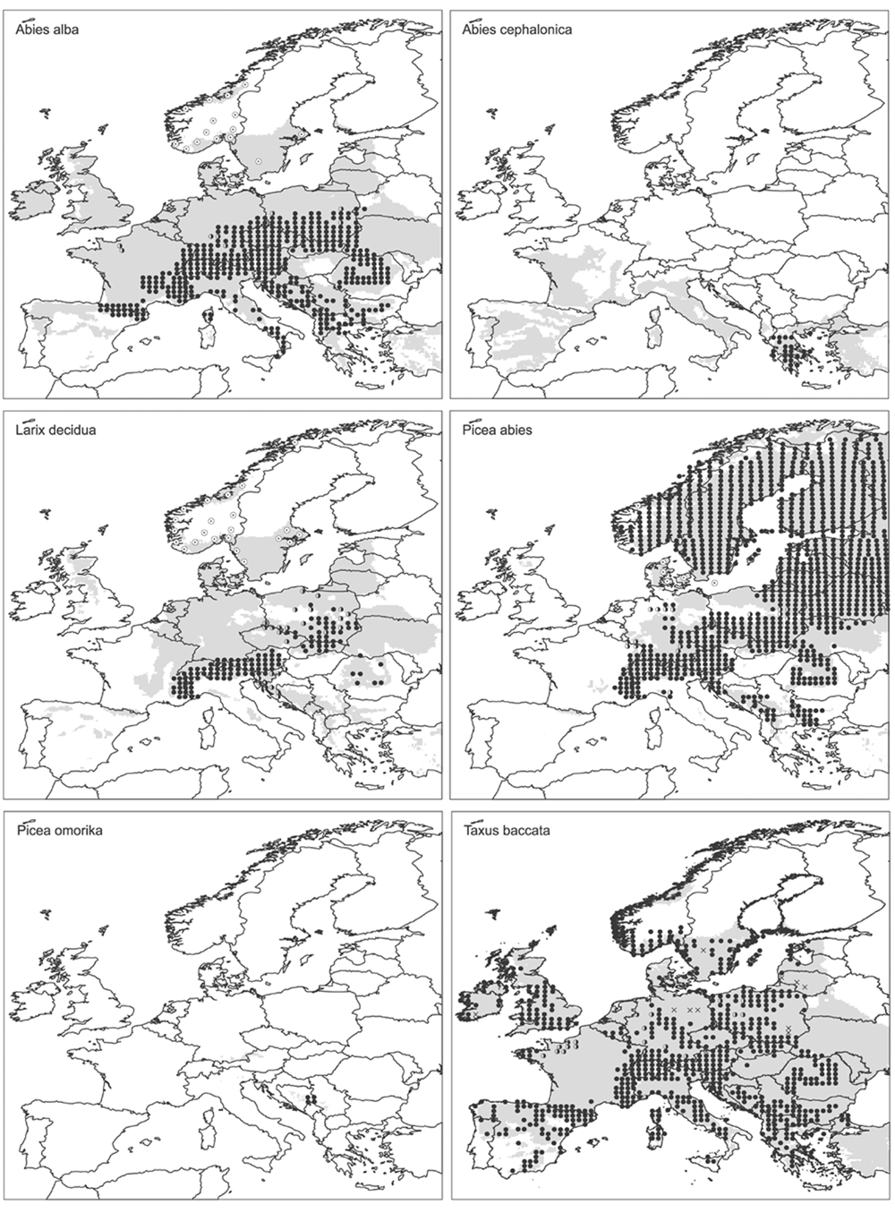
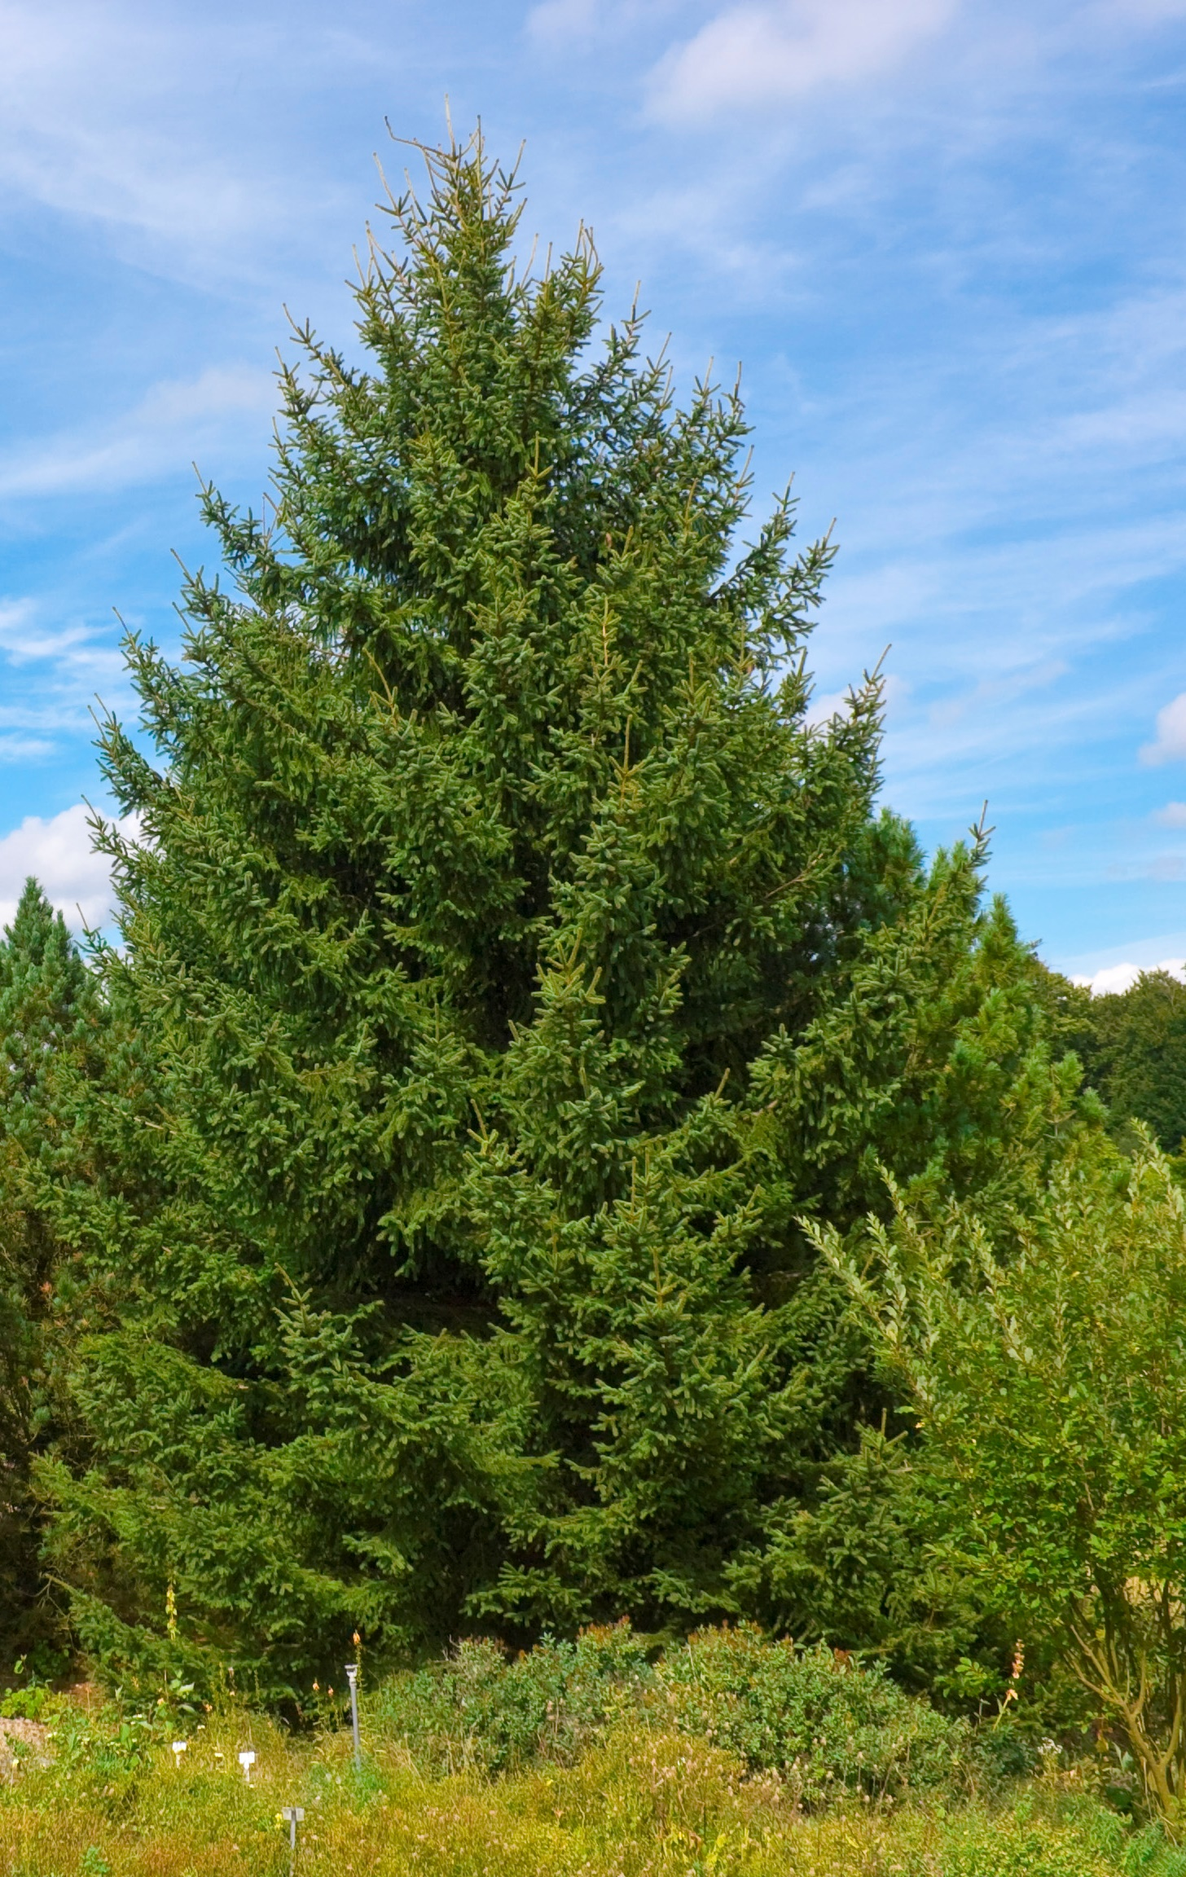
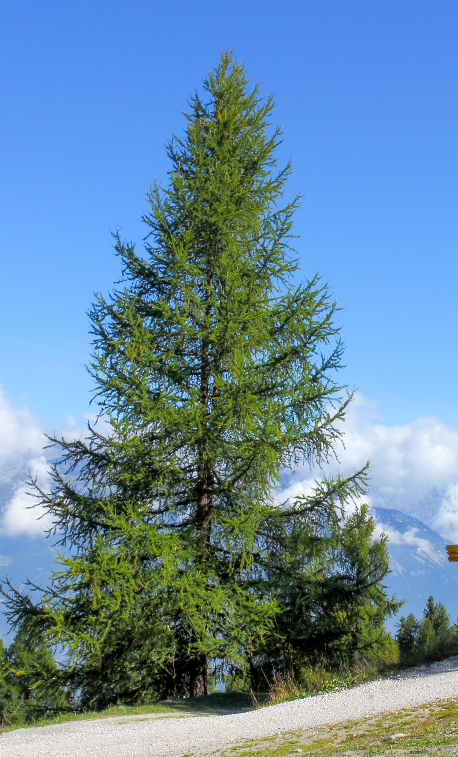
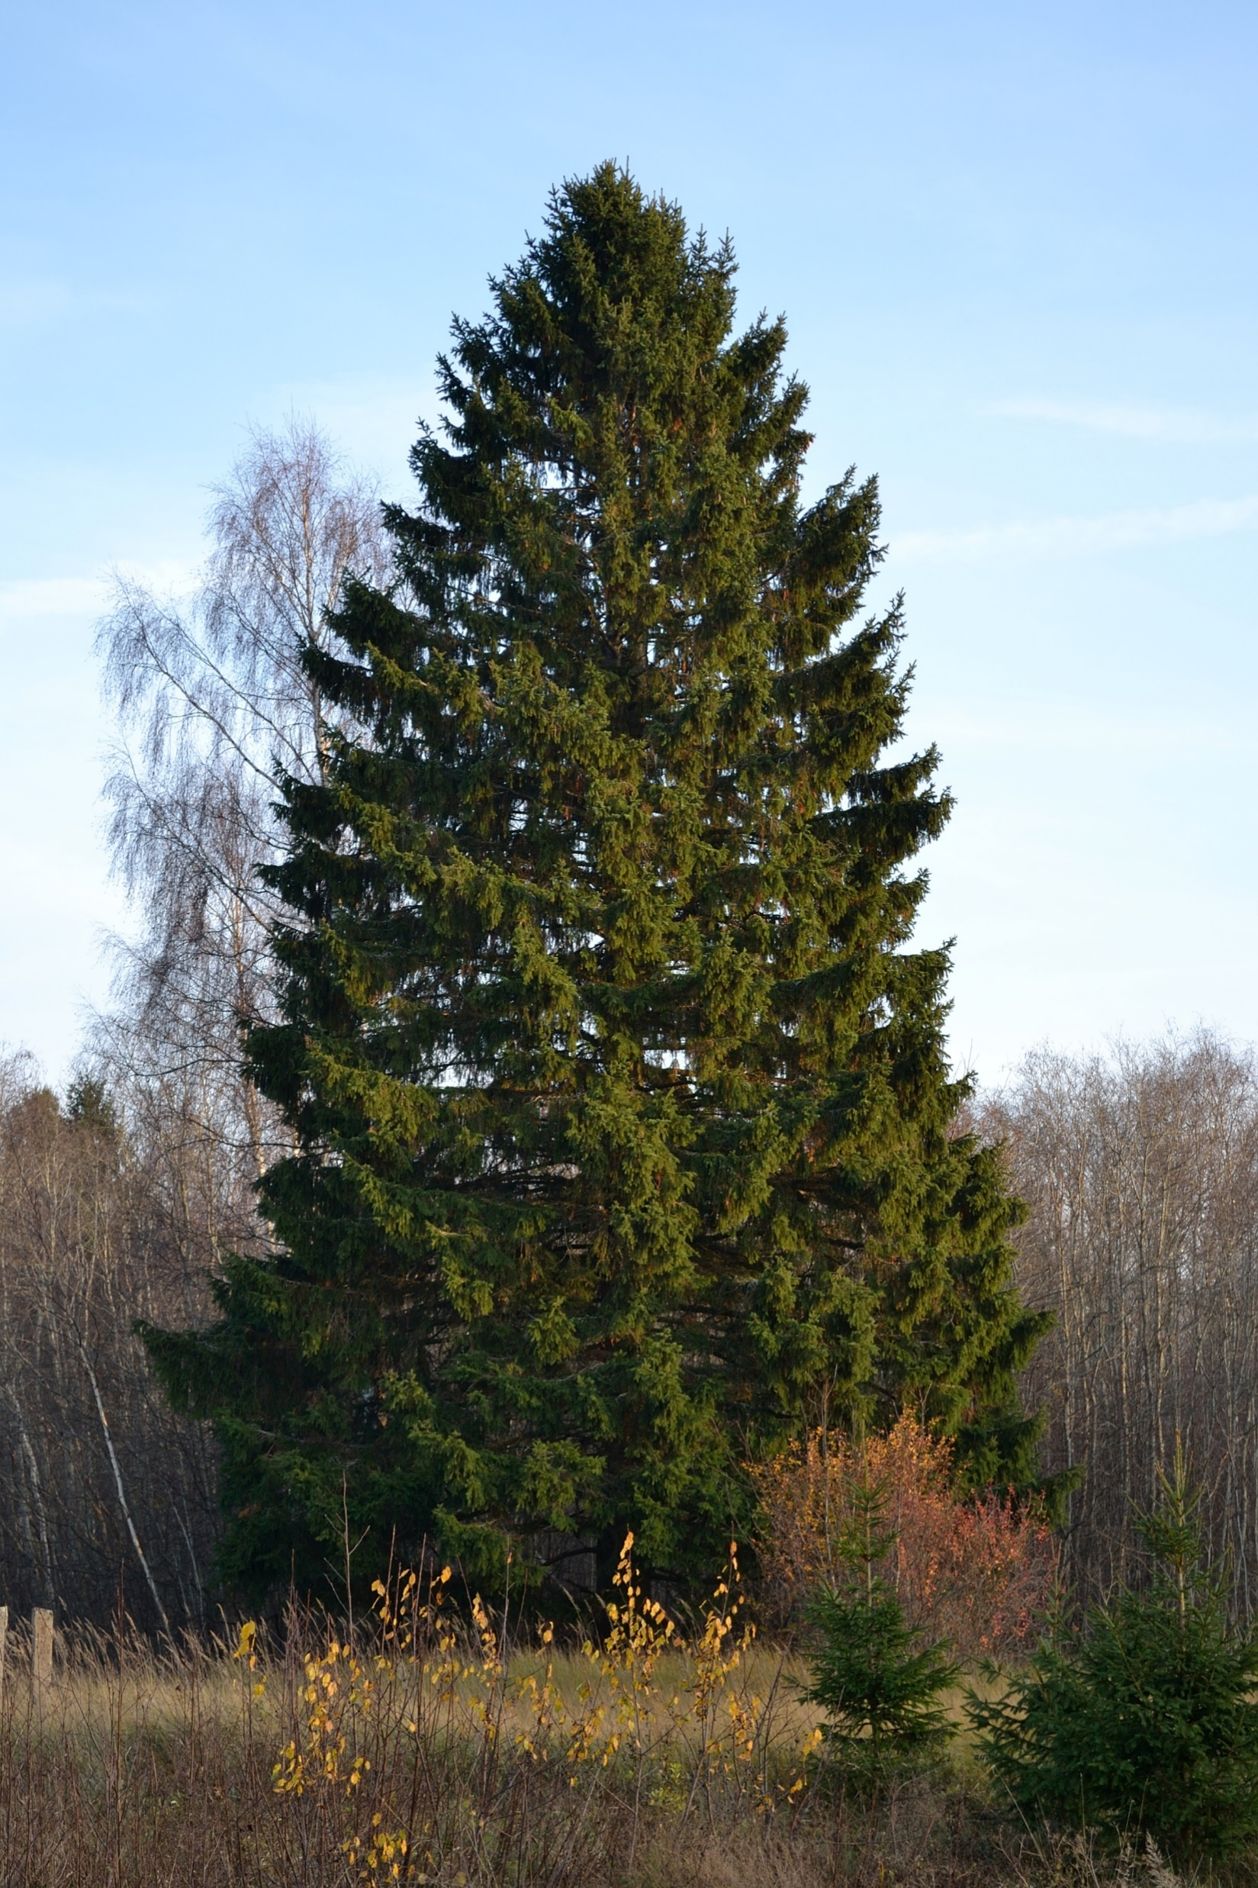
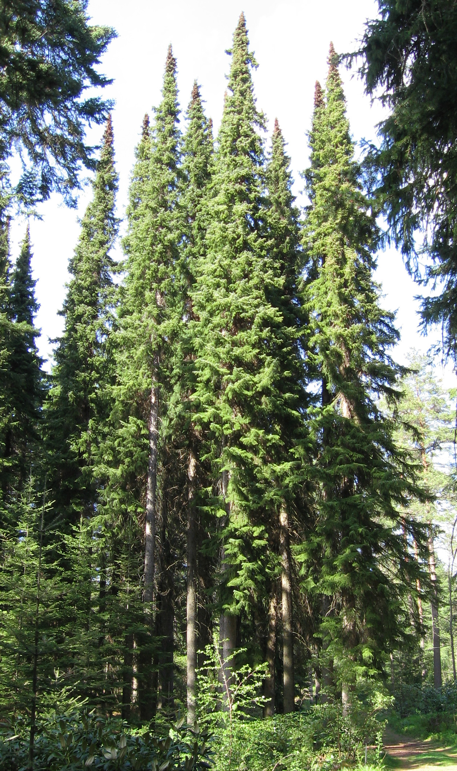
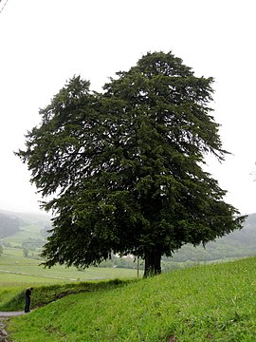
Dispersal limits
Species may be missing in parts of its range (B, C) and niche (E) because it can’t get there due to barriers or poor dispersal.
Svenning & Skov (2004) Ecology Letters
Notes:
In this panel we can probably all agree that biodiversity is one of the most valuable natural resources.
But things like climate change or habitat loss are a threat to biodiversity, to the extent that we hear about biodiversity crisis, or sixth mass extinction
For example, about 1% of vertebrate species have gone extinct because of humans

Slide 34
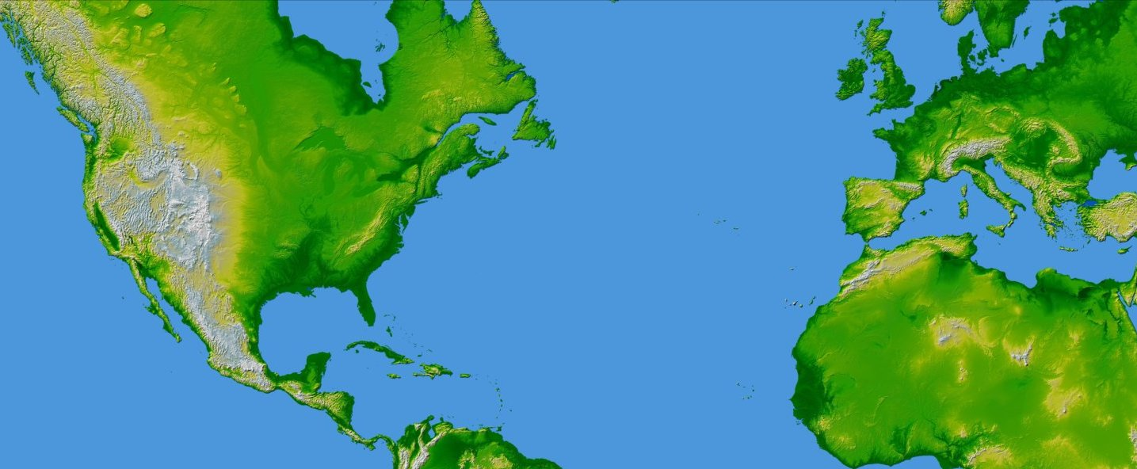
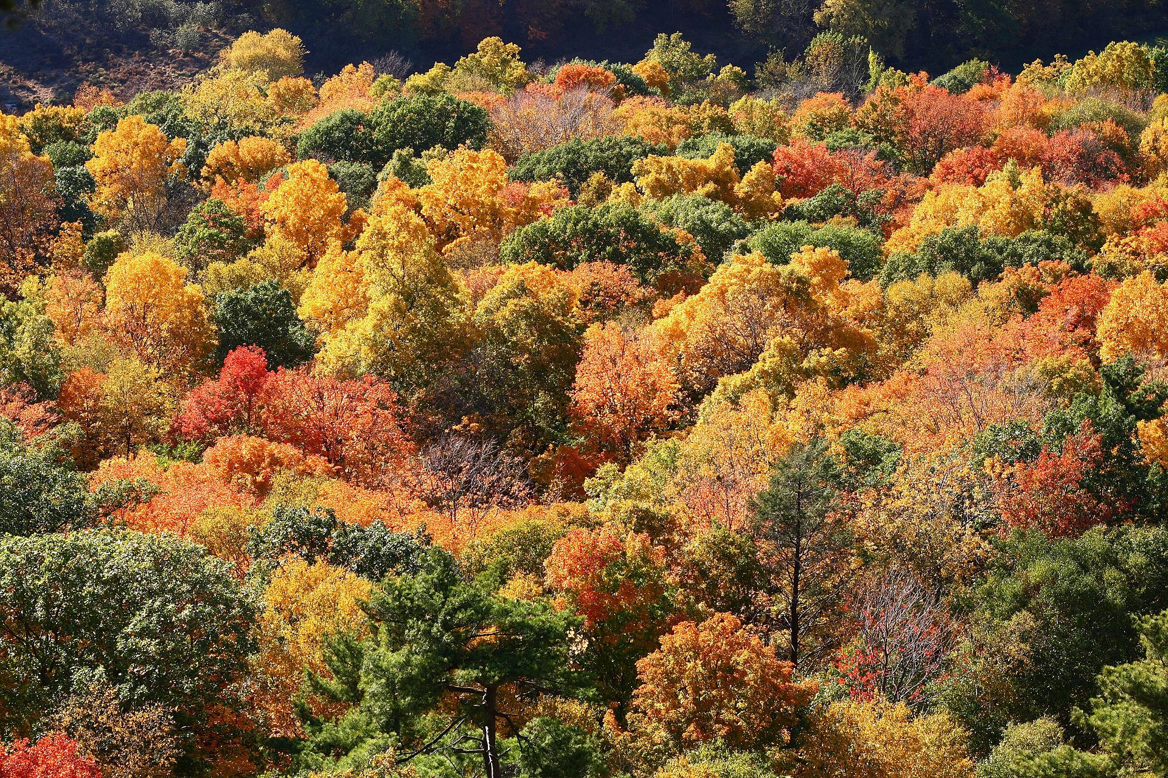
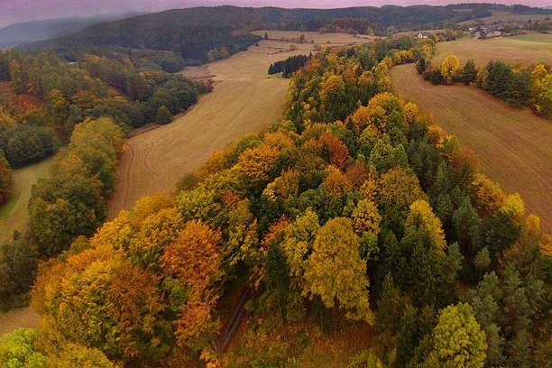
Dispersal limits
Species may be missing in parts of its range (B, C) and niche (E) because it can’t get there due to barriers or poor dispersal.
X
Connecticut, USA
Czech Republic, EU
Ricklefs & Schluter (1993), Keil & Chase (2019) Nature Ecology & Evolution
map from NASA (public domain)
Notes:
In this panel we can probably all agree that biodiversity is one of the most valuable natural resources.
But things like climate change or habitat loss are a threat to biodiversity, to the extent that we hear about biodiversity crisis, or sixth mass extinction
For example, about 1% of vertebrate species have gone extinct because of humans

Slide 35
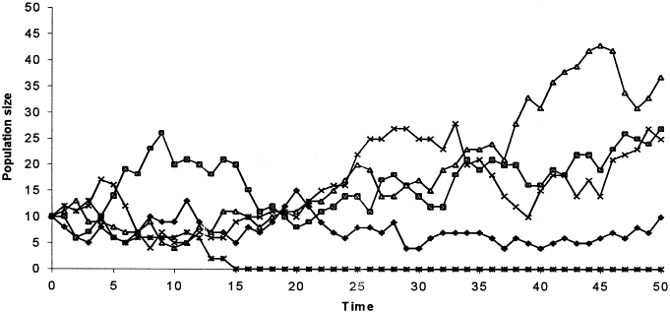
Demographic stochasticity
Species may be missing in parts of its range (B, C) and niche (E) because of random fluctuations of its population size due to randomness in birth and death (= demographic processes)
Applies particularly to areas/species with small populations
Notes:
In this panel we can probably all agree that biodiversity is one of the most valuable natural resources.
But things like climate change or habitat loss are a threat to biodiversity, to the extent that we hear about biodiversity crisis, or sixth mass extinction
For example, about 1% of vertebrate species have gone extinct because of humans

Slide 36
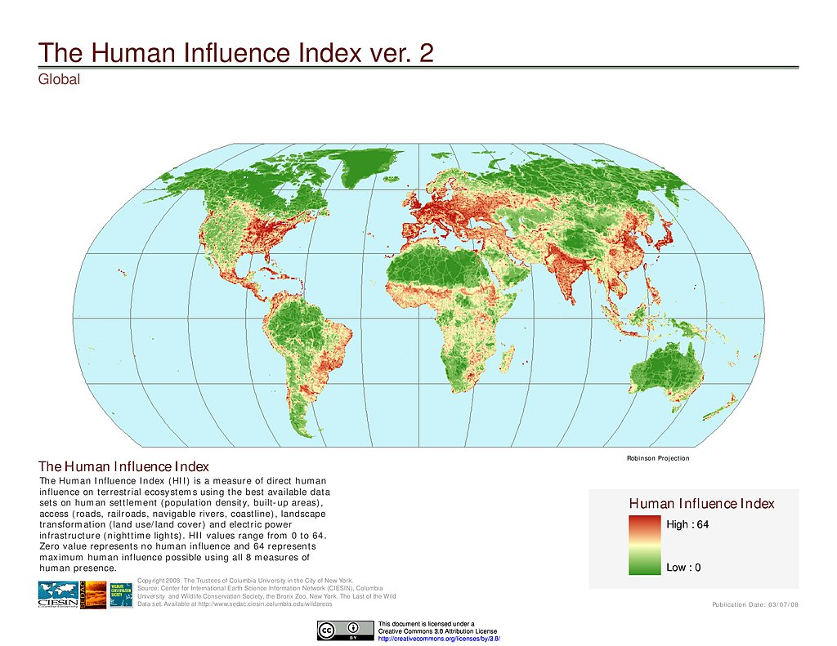
Humans
https://sedac.ciesin.columbia.edu/
Notes:
In this panel we can probably all agree that biodiversity is one of the most valuable natural resources.
But things like climate change or habitat loss are a threat to biodiversity, to the extent that we hear about biodiversity crisis, or sixth mass extinction
For example, about 1% of vertebrate species have gone extinct because of humans

Slide 37
Thank you. Questions?

